Slide 1
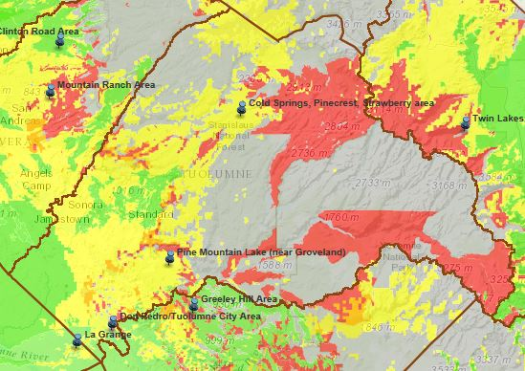
Tuolumne County – Broadband Availability: Served/Under-served/Un-served
COMBINED
Wireline, Mobile,
Fixed Wireless
Legend
Green: served
(combined 6 Mb/s downstream and
1.5 Mb/s upstream or greater)
Yellow: under-served
(combined 768 Kb/s downstream and
200 Kb/s upstream or greater)
Red: un-served
(below 768 Kb/s downstream and/or
200 Kb/s upstream or greater, or no
service)
Thumbtacks: Consortia
Priority Areas
Broadband availability
Data as of June 30, 2014

Slide 2
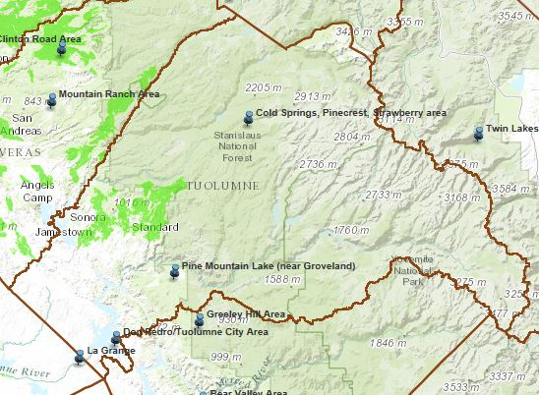
Tuolumne County – Broadband Availability: Served Wireline ONLY
WIRELINE ONLY
Legend
Green: served
(combined 6 Mb/s downstream and
1.5 Mb/s upstream or greater)
Thumbtacks: Consortia
Priority Areas
Broadband availability
Data as of June 30, 2014

Slide 3
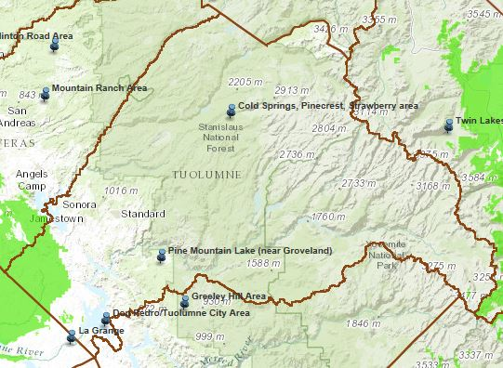
Tuolumne County – Broadband Availability: Served Mobile ONLY
MOBILE ONLY
Legend
Green: served
(combined 6 Mb/s downstream and
1.5 Mb/s upstream or greater)
Thumbtacks: Consortia
Priority Areas
Broadband availability
Data as of June 30, 2014

Slide 4
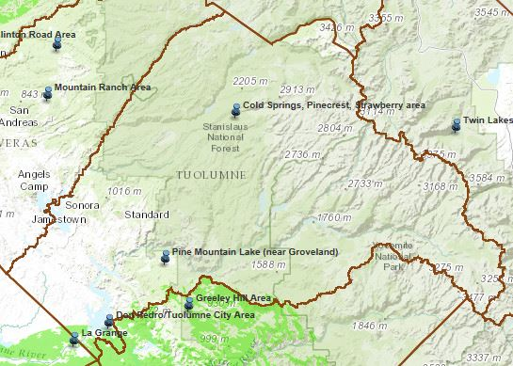
Tuolumne County – Broadband Availability: Served Fixed Wireless ONLY
FIXED WIRELESS ONLY
Legend
Green: served
(combined 6 Mb/s downstream and
1.5 Mb/s upstream or greater)
Thumbtacks: Consortia
Priority Areas
Broadband availability
Data as of June 30, 2014

Slide 5
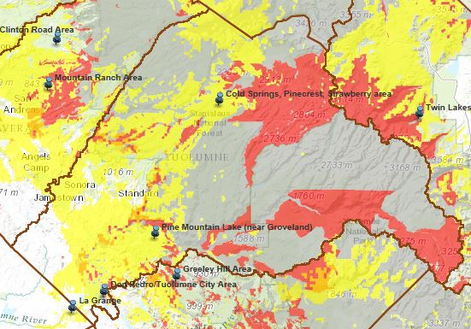
Tuolumne County – Broadband Availability: Combined Under-served & Un-served ONLY
COMBINED
Wireline, Mobile,
Fixed Wireless
Legend
Yellow: under-served
(combined 768 Kb/s downstream and
200 Kb/s upstream or greater)
Red: un-served
(below 768 Kb/s downstream and/or
200 Kb/s upstream or greater, or no
service)
Thumbtacks: Consortia
Priority Areas
Broadband availability
Data as of June 30, 2014

