Slide 1
CDBG-DR Draft Action Plan for October & December 2017 Wildfires, Debris Flows, and Mudslides PUBLIC MEETING
December 2018

Slide 2
AGENDA
Funding Overview
Disaster Overview
Action Plan Overview
Unmet Needs
Proposed Recovery Programs
Eligibility
Timeline
Question and Answer

Slide 3
GOALS AND OBJECTIVES
Provide an overview of Community Development Block Grant Disaster Recovery (CDBG-DR) requirements and timeline.
Provide an understanding of impacted areas, damages, and unmet recovery needs.
Provide an overview of the state’s proposed Action Plan.
Discuss recovery timeline.
Open for public comment.

Slide 4
DEPARTMENT OF HOUSING AND COMMUNITY DEVELOPMENT (HCD)
Mission: Provides leadership, policies, and programs to preserve and expand safe and affordable housing opportunities and promote strong communities for all Californians.
Grants and funding
Mobile home registration
Building standards
Planning and community development
Policy and research

Slide 5
OVERVIEW OF FUNDING AND DISASTER IMPACTS

Slide 6
FUNDING OVERVIEW
Unmet Recovery Needs – $124 million is available to meet unmet recovery needs; the state must address housing needs first.
$88 million in Mitigation funds – schedule and requirements TBD
Overall Benefit Requirement – 70% of the total allocation must benefit low and moderate income households (individuals whose income is below 80% of area median income).
Most Impacted and Distressed Areas – 80% of funds must be spent in these areas.
Documented Tie Back to the Disaster – Each project must have a documented tie back to the appropriate disaster.
Duplication of Benefits – CDBG-DR funds must address an identified unmet recovery need and cannot replace or duplicate other funding available to address the same need.

Slide 7
HOW DOES THE STATE ACCESS THE RECOVERY FUNDS?
The state will submit an Action Plan to HUD.
The Action Plan identifies the following information:
Detailed analysis of the unmet recovery needs.
Overview of the proposed recovery programs and how the funds will be managed.
HUD reviews and approves the Action Plan.
Once approved, a Grant Agreement is signed and a line of credit is established.
HCD does not have access to funding until the previous steps are completed

Slide 8
WHICH DISASTERS ARE COVERED BY THESE FUNDS?
FEMA 4344 – October 2017 Fires
Central LNU Complex
Pocket Fire – Sonoma County
Tubbs Fire – between Calistoga & Santa Rosa
Nuns Fire – Sonoma County
Atlas Fire – Napa & Solano Counties
Mendocino-Lake Complex
Redwood Valley – Mendocino County
Sulphur – Lake County
Redwood Valley
Sulphur
Pocket
Tubbs
Atlas
Nuns

Slide 9
WHICH DISASTERS ARE COVERED BY THESE FUNDS?
FEMA 4344 - October 2017 Fires
Wind Complex
Cascade and Laporte Fire
Lobo Fire
McCourtney Fire – Nevada County
Cascade and Laporte
Lobo
McCourtney

Slide 10
WHICH DISASTERS ARE COVERED BY THESE FUNDS?
4353 – December 2017 Fires, Mudflows, and Debris Flows
Thomas Fire – Ventura and Santa Barbara Counties
Rye Fire – Los Angeles County
Creek Fire – Angeles National Forest
Lilac Fire – San Diego County
Thomas
Rye
Creek
Lilac

Slide 11
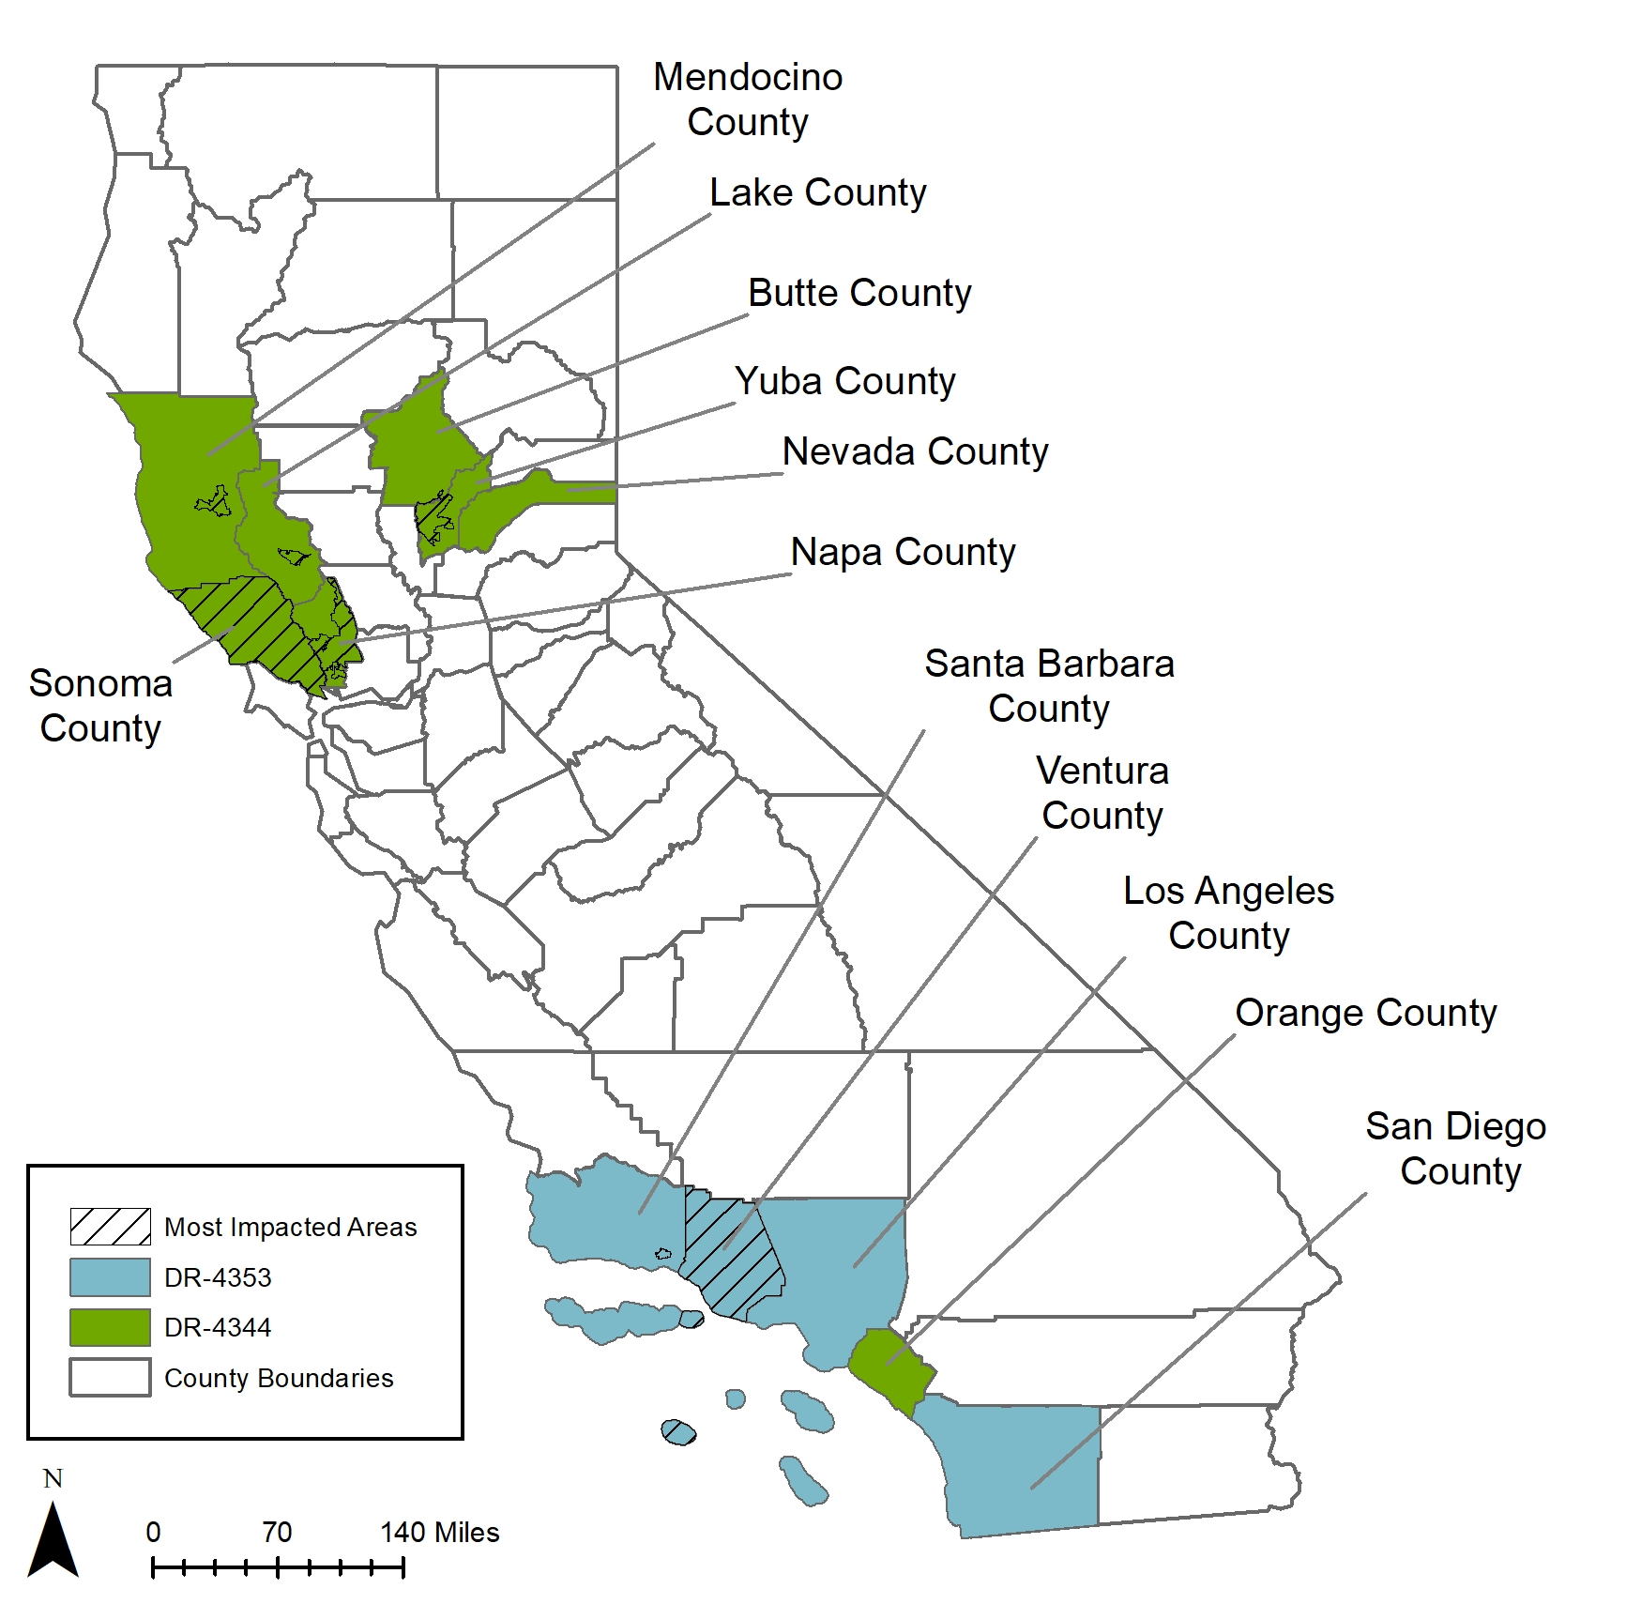
HUD MOST IMPACTED AND DISTRESSED AREAS
FEMA 4353 (Blue) & 4344 Counties (Green)
80% of funds must be spent in the following areas:
Counties
Sonoma
Ventura
Zip Codes
95470 (Mendocino)
95901 (Predominately Yuba)
94558 (Predominately Napa)
95422 (Clearlake)
93108 (Montecito)

Slide 12
HUD FY 2018 INCOME LIMITS – LOW AND MODERATE INCOME (80% AMI OR BELOW)
Geography | Persons in Family
 | 1 | 2 | 3 | 4 | 5 | 6 | 7 | 8
Butte | $33,900 | $38,750 | $43,600 | $48,400 | $52,300 | $56,150 | $60,050 | $63,900
Lake | $33,450 | $38,200 | $43,000 | $47,750 | $51,600 | $55,400 | $59,250 | $63,050
Los Angeles | $54,250 | $62,000 | $69,750 | $77,500 | $83,700 | $89,900 | $96,100 | $102,300
Mendocino | $33,950 | $38,800 | $43,650 | $48,500 | $52,400 | $56,300 | $60,150 | $64,050
Napa | $51,450 | $58,800 | $66,150 | $73,450 | $79,350 | $85,250 | $91,100 | $97,000
Nevada | $40,600 | $46,400 | $52,200 | $58,000 | $62,650 | $67,300 | $71,950 | $76,600
Orange | $61,250 | $70,000 | $78,750 | $87,450 | $94,450 | $101,450 | $108,450 | $115,450
San Diego | $54,500 | $62,300 | $70,100 | $77,850 | $84,100 | $90,350 | $96,550 | $102,800
Santa Barbara | $56,250 | $64,250 | $72,300 | $80,300 | $86,750 | $93,150 | $99,600 | $106,000
Sonoma | $55,000 | $62,850 | $70,700 | $78,550 | $84,850 | $91,150 | $97,450 | $103,700
Ventura | $56,800 | $64,900 | $73,000 | $81,100 | $87,600 | $94,100 | $100,600 | $107,100
Yuba | $33,600 | $38,400 | $43,200 | $48,000 | $51,850 | $55,700 | $59,550 | $63,400
State | $43,400 | $49,600 | $55,800 | $62,000 | $66,950 | $71,900 | $76,900 | $81,850

Slide 13
ACTION PLAN OVERVIEW

Slide 14
UNMET NEEDS SUMMARY
Category | Data Source | Total Impact | Resources Available | Unmet Need (Total Impact less Applied Resources)
Housing | FEMA IA | $209,630,395 | $23,723,406 | $185,906,989
Infrastructure | FEMA PA | $592,197,307 | $557,523,980 | $34,673,327
 | FEMA HMGP* | $1,118,748,393 | $648,572,968 | $ 470,175,423
Economic* | SBA – Commercial Loss | $123,619,322 | $33,084,100 | $90,535,222
Agriculture* | Local | $259,438,082 | N/A | $259,438,082
Total |  | $2,303,633,499 | $1,262,904,454 | $1,040,729,043
*Not addressed in the Unmet Needs Action Plan at this time.

Slide 15
UNMET NEEDS SUMMARY - ALTERNATIVE
Category | Data Source | Total Impact | Resources Available | Unmet Need (Total Impact less Applied Resources)
Housing | CAL FIRE/SBA | $2,283,300,000* | $582,290,191** | $1,701,009,809
Infrastructure | FEMA PA | $592,197,307 | $557,523,980 | $34,673,327
 | FEMA HMGP | $1,118,748,393 | $648,572,968 | $ 470,175,423
Economic | SBA – Commercial Loss | $123,619,322 | $33,084,100 | $90,535,222
Agriculture | Local | $259,438,082 | N/A | $259,438,082
Total |  | $4,377,303,104 | $1,821,471,239 | $2,555,831,863
*Based on CAL FIRE Destroyed and 51-75% Damaged x Avg Basis of Reconstruction
**Includes FEMA IHP and SBA Structural Damage

Slide 16
PROPOSED RECOVERY PROGRAMS

Slide 17
WHAT PROGRAMS ARE BEING PROPOSED?
Housing: Two programs that address owner-occupant and rental housing recovery.
Owner-Occupied ($48 million) – Rehab or reconstruction of owner-occupied properties. Small Rental (1-4 units) may be considered after survey period is complete.
Multi-Family ($67 million) – Rehab, reconstruction or new construction of large-scale housing developments.
Infrastructure ($3.5 million): Repair funding limited to required match for approved FEMA Public Assistance (PA) public utility projects.

Slide 18
PROPOSED OWNER-OCCUPIED HOUSING PROGRAM
HCD will manage the program.
Rehab or reconstruction of owner-occupied residences.
Max gap finance award of up to $150,000 for a single property.
Assistance will be provided as a grant.
Surveys will be conducted prior to application period to assess and prioritize the universe of potential applicants.
Applicants will be assigned a case manager who will guide applicants from application through closeout.

Slide 19
PROPOSED PROGRAM PRIORITIZATION
Owner-Occupied Rehabilitation and Reconstruction Program
Applicant Prioritization Tiers*
 | Geography |  | Owner-occupant Household Income
 | 7 Most Impacted Counties and Zips Only | All Areas with Federal Disaster Declaration | LMI Only | All
Tier 1 | √ |  | √
Tier 2 |  | √ | √
Tier 3 | √ |  |  | √
Tier 4 |  | √ |  | √
Criteria will ensure priority is given to low-to-moderate income households.
HCD is required to expend 80% of the grant in HUD-designated Most Impacted and Distressed areas.
*Owner-occupied households with a household member that is disabled or has access or functional needs are given first priority within each established tier.

Slide 20
SURVEY FOR POTENTIAL PROGRAM APPLICANTS
HCD Submits Action Plan
Action Plan Approval by HUD
Survey of Potential Applicants
Action Plan Amendment (If Needed)
Final Program Design
Program Launch
Survey made available following HUD’s approval of the Action Plan.
Information used to refine program allocations, prioritization criteria, workflows and other design components to ensure an effective and efficient program.
Allows homeowner to continue to repair their home during the program design phase.
Based on outcomes, an Action Plan Amendment is submitted to make needed adjustments.

Slide 21
ENVIRONMENTAL REVIEW AND STOP WORK ORDER
Use of a survey allows for work to continue up to the submittal of a program application.
Upon submittal of an application, work on the property must stop until the required environmental review process is completed.
In most cases, the environmental review will be completed concurrent with the damage assessment process and will not cause delays.
Once the environmental review is completed, funds can be committed to the project and work can commence.

Slide 22
WHO SHOULD COMPLETE THE SURVEY?
Homeowners whose primary residence was located in the declared disaster area.
The property was damaged as a direct result of the qualified disasters (FEMA 4353 & 4344).
Households with all ranges of incomes are able to complete the survey but funding will be awarded based on prioritization criteria.

Slide 23
WHO IS ELIGIBLE TO PARTICIPATE IN THE PROGRAM?
Homeowners must provide evidence of ownership and occupancy at the time of the disaster(s).
Information on income and assets collected to determine household income level and program prioritization.
Documentation of resources available to address disaster impacts (e.g. FEMA, insurance, and SBA) must be provided to calculate need for CDBG-DR funding.
Funding is not eligible for second homes.

Slide 24
SAMPLE AWARD CALCULATION
Example: Ms. Jones suffers $200,000 damage to her property from the Tubbs fire. She receives $100,000 from private insurance and is awarded $15,000 from FEMA to repair her home. Ms. Jones would be eligible for $85,000 in CDBG-DR funding.
Source | Amount
Cost to Rebuild or Repair | $200,000
Private Insurance | ($100,000)
FEMA | ($15,000)
Maximum CDBG-DR Award | $85,000
Special Considerations for SBA Assistance
Recent federal legislation allows for a reconsideration of how SBA loans are treated relative to duplication of benefits. Specific guidance will be provided in the program guidelines.

Slide 25
PROPOSED MULTIFAMILY HOUSING PROGRAM
Provides gap financing for large-scale housing developments.
CDBG-DR funding would be limited to use on affordable units.
Local governments State will make funding available to local governments with locals oversee projects approved by State.
Per unit maximum will be based on HOME subsidy limits.

Slide 26
PROPOSED MULTIFAMILY ALLOCATIONS
Allocation Summary | Total Funding | Funding to Most Impacted and Distressed Areas
Sonoma County | $4,698,809 | $4,698,809
City of Santa Rosa | $38,469,772 | $38,469,772
Ventura County | $2,756,047 | $2,756,047
City of Ventura | $4,601,064 | $4,601,064
Mendocino County | $6,591,778 | $6,235,730
Yuba County | $1,666,091 | $1,622,677
Napa County | $420,094 | $0
City of Napa | $2,889,774 | $2,851,517
Lake County | $1,157,983 | $1,114,570
Santa Barbara County | $588,504 | $57,028
City of Santa Barbara | $848,011 | $848,011
Butte County | $679,013 | $0
Los Angeles County | $590,987 | $0
Nevada County | $424,028 | $0
San Diego County | $405,845 | $0
Total | $66,787,799 | $63,255,225
Funding is based on a formula to determine a proportionate share of the total program allocation based on the impacts to that jurisdiction.

Slide 27
PROPOSED FEMA PUBLIC ASSISTANCE (FEMA PA) MATCH PROGRAM
Provides funding for required state/local match on approved FEMA-PA projects that directly support housing recovery.
Initial focus is limited to public utilities damaged by disaster.
State will make funding available to local government, local government will oversee projects approved by State.

Slide 28
PROPOSED FEMA PA MATCH ALLOCATIONS
County | FEMA PA Local Match (D & F only)*
Lake County | $6,637
Los Angeles County | $0
Mendocino County | $18,770
Napa County | $309,660
Nevada County | $0
Orange County | $1,446
San Diego County | $0
Santa Barbara County | $472,780
Sonoma County | $1,238,072
Ventura County | $1,470,533
Yuba County | $13,905
Total Match | $3,531,803
The maximum assistance allowable per project is the amount necessary to meet the local match requirement.
Proposed projects must be approved for FEMA PA funds and located in a Most Impacted and Distressed area, or otherwise have been impacted by DR-4344 or DR-4353.
*Based on FEMA PA data collected August 2018.

Slide 29
PLACEHOLDERS – NO CURRENT FUNDING
Owner-Occupied Program – Other Eligible Activities
Reimbursement - Payment made directly to an eligible homeowner after they have completed all or a portion of the repair or rebuild work on their property.
Small Rental Repair - Provide financial assistance, such as forgivable loans, to small rental property owners (typically 1 – 4 units) to rebuild affordable rental housing stock.
Economic Development Program
Program funding types include workforce recovery and small business recovery programs.

Slide 30
GRANT ALLOCATION SUMMARY
CDBG-DR Funding Summary |  | % of Total
Administration | $6,207,750 | 5.0%
Program Allocations | $117,947,250 | 95.0%
Housing Programs | $114,415,447 | 92.2%
Owner-Occupied Rehab and Recon Program | $47,627,647.75 | 38.4%
Multifamily Housing Program | $66,787,799.21 | 53.8%
FEMA PA Match Program | $3,531,803 | 2.8%
Total CDBG-DR Funds | $124,155,000 | 100.0%

Slide 31
TIMELINE AND NEXT STEPS

Slide 32
TIMELINE – UNMET NEED ACTION PLAN
State Publishes Action Plan for Public Comment 11/13 -12/12
Grant Agreement Executed and Line of Credit Established - Estimate
State Submits Certifications and Implementation Plan to HUD – 10/19
State Submits Action Plan to HUD – 12/18
Effective Date of Federal Register Notice – 8/20
HUD Approves State Action Plan – 2/1
Notice of Appropriation: $124.55 million
HUD Review – 45 Days
Public Meetings
April
May-July
August
Sept.
Oct.
Nov.
Dec.
Jan.
Feb.
OUTREACH AND ENGAGEMENT
ACTION PLAN DEVELOPMENT

Slide 33
ACTION PLAN EVOLUTION
HCD will continue to assess unmet recovery needs in partnership with local, state, and federal officials.
Program allocations will be examined on an ongoing basis to ensure funds are being used effectively and in a timely manner.
Actual and projected expenditures are monitored to ensure compliance with overall benefit requirement and the requirement to expend 80% of funds in Most Impacted and Distressed areas.
When appropriate, HCD will amend the Action Plan to adjust program allocations, program design elements, or activate new programs.
Changes to the Action Plan are completed as substantial or non-substantial amendments.

Slide 34
WHEN WILL FUNDING BE AVAILABLE? DRAFT TIMELINE
February 2019 – Department of Housing and Urban Development(HUD) approves Unmet Need Action Plan.
February – March 2019 – State receives Grant Agreement and line of credit from HUD and finalizes CDBG-DR program design.
March – April 2019 – State launches Homeowner Survey to understand current program interest. HCD markets Program Survey in coordination with community stakeholders.
April – May 2019 – Program launch and homeowner application intake begins. HCD continues marketing in coordination with local stakeholders and opens applications based on prioritization tiers.
Summer 2019 – Initial awards to homeowners.

Slide 35
WHAT CAN YOU DO TO STAY INVOLVED?
Sign up: Sign in tonight to stay in touch with HCD by email.
Provide Comments on the Action Plan: Public Comment Draft of Action Plan is available on www.hcd.ca.gov. All public comment is addressed in the Action Plan prior to submittal to HUD.
Housing Survey: The housing survey will launch in early 2019. HCD encourages impacted property owners to complete the survey.

Slide 36
ADDITIONAL INFORMATION AND PUBLIC COMMENT
For further information on HCD’s CDBG-DR Recovery Programs, please visit: hcd.ca.gov
Comments on the CDBG-DR Action Plan can be submitted via email during the public comment period to DisasterRecovery@hcd.ca.gov
Public comment period will last for 30 days, ending on December 12, 2018.

